Slide 1
Advanced Concepts

Slide 2
Outline
Stored Procedures (SPs)
Functions
Triggers
Cursors
Exception handling

Slide 3
Stored Procedures
A stored procedure
Is one or more SQL commands stored in a database as an executable object.
Can be called interactively, from within client application code, from within other stored procedures, and from within triggers.
Can have input and output parameters
Can return a number of result sets and a status code.

Slide 4
SP - Implementation
Depending on the database system, stored procedures can be implemented in a variety of programming languages, for example SQL, Java, C, or C++.
Database system | Implementation language
Microsoft SQL Server | Transact-SQL and various .NET Framework languages
DB2 | SQL PL or Java
Oracle | PL/SQL or Java
PostgreSQL | PL/pgSQL, can also use own function languages such as pl/perl or pl/php

Slide 5
SPs – Syntax MS SQL Server
CREATE PROCEDURE procedure_name
(parameter1 datatype1 [= dafault_value [OUTPUT]],
parameter2 datatype2 [= dafault_value [OUTPUT]],
...)
AS
BEGIN
SQL Statements ...
[ RETURN scalar_expression ]
END;
Eg1. With Return Status code
CREATE PROCEDURE title_authors (@au_lname VARCHAR(50))
AS
BEGIN
SELECT a.au_lname, a.au_fname, t.title
FROM titles t INNER JOIN titleauthor ta ON t.title_id = ta.title_id
INNNER JOIN authors a ON ta.au_id = a.au_id
WHERE a.au_lname = @au_lname
RETURN 0
END
Eg2. With Output Param
CREATE PROC ytd_sales @title varchar(80), @ytd_sales int OUTPUT
AS
SELECT @ytd_sales = ytd_sales FROM titles
WHERE title = @title
RETURN

Slide 6
SPs – Calling SPs
[EXEC[UTE]] [@status =] [schema].procedure_name
[[@param_name =] expression [output][, ... ]]
Eg1:
EXEC title_authors @au_lname = ‘John’
Eg2: With return status code
Declare @ret_code INT
EXEC @ret_code = title_authors @au_lname = ‘John’
Eg3: With Output param
DECLARE @sales_up_to_today int
EXEC ytd_sales ‘Life Without Fear’, @sales_up_to_today OUTPUT
PRINT ‘Sales this year until today’’s date: ‘ + CONVERT(VARCHAR(10), @sales_up_to_today) + ‘.’

Slide 7
SPs - Advantages
Modular programming - Subroutines and functions are often used in ordinary 3GL and 4GL languages (such as C, C++, and Microsoft Visual Basic) to break code into smaller, more manageable pieces. The same advantages are achieved when using stored procedures, with the difference that the stored procedure is stored in SQL Server and can be called by any client application.
Restricted, function-based access to tables - A user can have permission to execute a stored procedure without having permissions to operate directly on the underlying tables.
Reduced network traffic - Stored procedures can consist of many individual SQL statements but can be executed with a single statement. This allows you to reduce the number and size of calls from the client to the server.
Faster execution - Stored procedures’ query plans are kept in memory after the first execution. The code doesn’t have to be reparsed and reoptimized on subsequent executions.
Enforced consistency - If users modify data only through stored procedures, problems that often result from ad hoc modifications (such as omitting a crucial WHERE clause) are eliminated.
Reduced operator and programmer errors - Because less information is being passed, complex tasks can be executed more easily, with less likelihood of SQL errors.
Automating complex or sensitive transactions - If all modifications of certain tables take place in stored procedures, you can guarantee the data integrity on those tables.

Slide 8
Functions
Most DBMS provide inbuilt functions. For eg
String functions – LEN() ,LEFT(),RIGHT(),SUBSTRING(), …
Aggregate functions – MIN() , MAX() , AVG() ,…
And many more functions
Provide features to create user-defined functions.
User-defined functions are routines that
Accept parameters
Perform an action, such as a complex calculation
Return the result of that action as a value. The return value can either be
A single scalar value (scalar function )
A result set (table function).

Slide 9
Functions – MS SQL Server
SQL Server supports three types of user-defined functions
Scalar functions
Inline table-valued functions
Multistatement table-valued functions

Slide 10
Functions – Scalar Functions
A scalar function is like the standard built-in functions provided with SQL Server. It returns a single scalar value that can be used anywhere a constant expression can be used in a query
Def:
CREATE FUNCTION AverageBookPrice(@booktype varchar(12) = ‘%’)
RETURNS money
AS
BEGIN
DECLARE @avg money
SELECT @avg = avg(price)
FROM titles
WHERE type like @booktype
RETURN @avg
END
Call:
select title_id, type, price from titles
where price > dbo.AverageBookPrice(‘popular_comp’)

Slide 11
Functions – Table-valued functions
A table-valued user-defined function returns a rowset instead of a single scalar value.
You can invoke a table-valued function in the FROM clause of a SELECT statement, just as you would a table or view.
In some situations, a table-valued function can almost be thought of as a view that accepts parameters, so the result set is determined dynamically.
A tablevalued function specifies the keyword TABLE in its RETURNS clause

Slide 12
Functions -Inline Table-Valued Functions
An inline table-valued function specifies only the TABLE keyword in the RETURNS clause, without table definition information.
The code inside the function is a single RETURN statement that invokes a SELECT statement.
Def:
CREATE FUNCTION AveragePricebyType (@price money = 0.0)
RETURNS table
AS
RETURN ( SELECT type, avg(isnull(price, 0)) as avg_price
FROM titles
group by type
having avg(isnull(price, 0)) > @price
)
Call :
select * from AveragePricebyType (15.00)

Slide 13
Functions - Multistatement Table-Valued Functions
Multistatement table-valued functions differ from inline functions in two major ways:
The RETURNS clause specifies a table variable and its definition.
The body of the function contains multiple statements, at least one of which populates the table variable with data values.
Def:
CREATE FUNCTION AveragePricebyType2 (@price money = 0.0)
RETURNS @table table (type varchar(12) null, avg_price money null)
AS
begin
insert @table
SELECT type, avg(isnull(price,0)) as avg_price
FROM titles
group by type
having avg(isnull(price, 0)) > @price
return
end
Call:
select * from AveragePricebyType2 (15.00)

Slide 14
Functions - Advanages
Modular programming - You can create the function once, store it in the database, and call it any number of times in your program. User-defined functions can be modified independently of the program source code.
Faster execution - Similar to stored procedures, user-defined functions reduce the compilation cost SQL code by caching the plans and reusing them for repeated executions. This means the user-defined function does not need to be reparsed and reoptimized with each use resulting in much faster execution times.
Reduce network traffic - An operation that filters data based on some complex constraint that cannot be expressed in a single scalar expression can be expressed as a function. The function can then invoked in the WHERE clause to reduce the number or rows sent to the client.

Slide 15
Indexes in Microsoft SQL Server
Indexes are organized as B-trees.
Each page in an index B-tree is called an index node.
The top node of the B-tree is called the root node.
The bottom level of nodes in the index is called the leaf nodes.
Any index levels between the root and the leaf nodes are collectively known as intermediate levels.
The pages in each level of the index are linked in a doubly-linked list.
SQL Server primarily supports 2 types of indexes
CLUSTERED Index
NON-CLUSTERED Index

Slide 16
Clustered Index
A clustered index is a special type of index that reorders the way records in the table are physically stored.
The root and intermediate level nodes contain index pages holding index rows
Each index row contains a key value and a pointer to either an intermediate level page in the B-tree, or a data row in the leaf level of the index.
Leaf node contains the actual data pages.
The data row of the table are sorted and stored in the table based on their clustered index key (i.e. based on the index column(s)).
You can have only one clustered index per table.

Slide 17
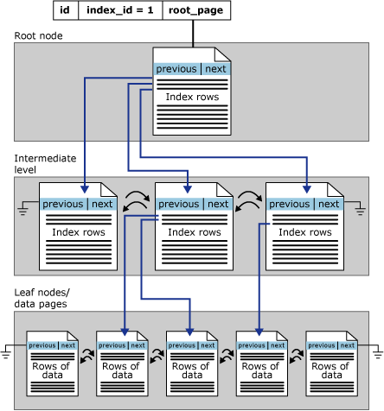
Clustered Index

Slide 18
Clustered Index
CREATE CLUSTERED INDEX <index name> ON <table name> (<column name list>)
Eg:
CREATE CLUSTERED INDEX IX_CUSTOMER_id ON CUSTOMER(id)

Slide 19
Clustered Index
Potential candidates for the clustered index:
Columns with a number of duplicate values that are searched frequently, for example, WHERE last_name = ‘Smith’.
Columns that are often specified in the ORDER BY / GROUP BY clause
Columns that are often searched for within a range of values, for example, WHERE price between $10 and $20.
Columns, other than the primary key, that are frequently used in join clauses.
Queries that return large result sets.

Slide 20
Clustered Index
Clustered indexes are not a good choice for:
Columns that undergo frequent changes: This results in the entire row moving (because SQL Server must keep the data values of a row in physical order). This is an important consideration in high-volume transaction processing systems where data tends to be volatile.
Wide keys: The key values from the clustered index are used by all nonclustered indexes as lookup keys and therefore are stored in each nonclustered index leaf entry.

Slide 21
Non-Clustered Index
A nonclustered index is a special type of index in which the logical order of the index does not match the physical stored order of the rows on disk.
Leaf node contains index pages instead of data pages.
Each index row in the nonclustered index contains the nonclustered key value and a row locator. This locator points to the data row in the clustered index or heap having the key value
Heap: The row locator is a pointer to the row. Row locator is built based on the following. ROW ID (RowLocator)= file identifier + page number + row number on the page
Clustered Index : Row locator is the clustered index key for the row
You can have up to 249 Non Clustered Index per table.

Slide 22
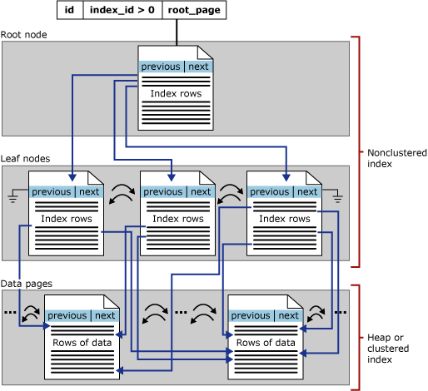
Non-Clustered Index

Slide 23
Non-Clustered Index
CREATE [NONCLUSTERED] INDEX <index name> ON <table name> (<column name list>)
Eg:
CREATE NONCLUSTERED INDEX IX_CUSTOMER_name ON CUSTOMER(name)

Slide 24
Non-Clustered Index
Potential candidates for nonclustered indexes for your environment:
Columns referenced in SARGs or join clauses that have a relatively high selectivity(the density value is low).
Columns referenced in both the WHERE clause and the ORDER BY clause
Nonclustered indexes are useful for single-row lookups, joins, queries on columns that are highly selective, or queries with small range retrievals.

Slide 25
Non-Clustered Index
Index with Included Columns
Functionality of nonclustered indexes can be extended by adding nonkey columns to the leaf level of the nonclustered index
An index with included nonkey columns can significantly improve query performance when all columns in the query are included in the index either as key or nonkey columns.
Notes:
Performance gains are achieved because the query optimizer can locate all the column values within the index; table or clustered index data is not accessed resulting in fewer disk I/O operations.

Slide 26
Questions
?

